Slide 1
Sentimental Analysis for Amazon Reviews
Team Incognito
Apoorva Uppala(026697591)
Aishwarya Bhosale(026735915)

Slide 2
Table of contents
What is Sentiment Analysis?
Applications
Steps for Performing Analysis
Results
Word Cloud
Future Work
Conclusion
Types of Sentiment Analysis
Why Is Sentiment Analysis Important?

Slide 3
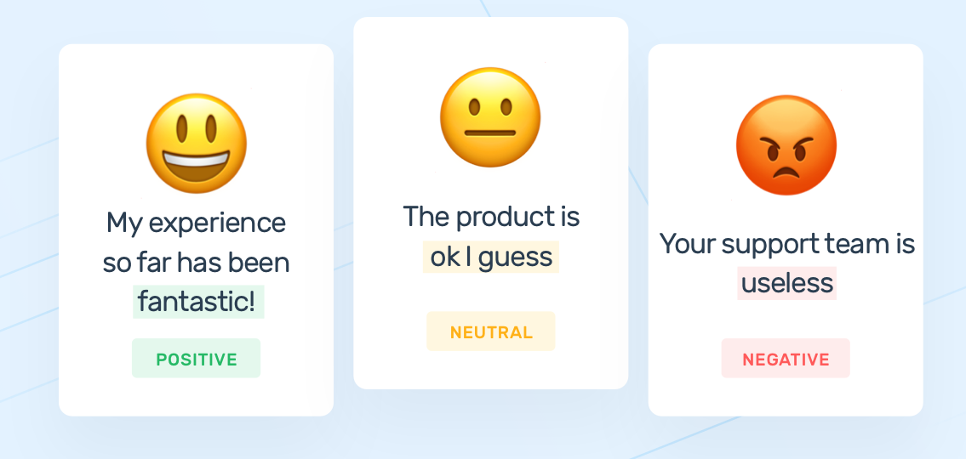
What is Sentiment Analysis?
Sentiment Analysis is the process of determining whether a piece of writing is positive, negative or neutral.
Sentiment analysis is often used in business to detect sentiment in social data, gauge brand reputation, and understand customers.

Slide 4
Types of Sentiment AnaLysis
Fine-grained Sentiment Analysis
1
Emotion detection
2
Aspect-based Sentiment Analysis
3
Multilingual sentiment analysis
4

Slide 5
Why is sentiment analysis important?
Sorting Data at Scale
Real-Time Analysis
Consistent criteria

Slide 6
Applications
Social media monitoring
Customer support
Customer feedback
Brand monitoring and reputation management
Voice of customer (VoC)
Voice of employee
Product analysis
Market research and competitive research

Slide 7
Steps for Performing Analysis
Business Problem.
Finding an appropriate dataset.
Splitting the data into train and test data.
Performing Data Exploration.
Correlation.
Sentiment Analysis.
Cleaning the data.
Testing Models

Slide 8
problem solution
Which product categories has lower reviews / maybe inferior products?
Which product have higher reviews / maybe superior products?
Which products should be kept, dropped from Amazon’s product roster (which ones are junk?)
Associate positive and negative words/sentiments for each product in Amazon’s Catalog
By using Sentiment analysis, can we predict scores for reviews based on certain words

Slide 9
DataSet
We used the dataset form Kaggle. https://www.kaggle.com/datafiniti/consumer-reviews-of-amazon-products
Total Number Of Record: 34661
Atrribute Name | Sample Record Text
Id | 123456
Name | All-New Fire HD 8 Tablet, 8 HD Display, Wi-Fi, 16 GB - Includes Special Offers, Magenta
Asins | B01AHB9CN2
Brand | Amazon
Categories | Electronics,iPad & Tablets,All Tablets,Fire Tablets,Tablets,Computers & Tablets
Manufacturer | Amazon
Reviews.rating | 4
Reviews.text | This product so far has not disappointed. My children love to use it and I like the ability to monitor control what content they see with ease.
Reviews.title | Kindle
Reviews.username | Adapter

Slide 10

Splitting the DatA
Before we explore the dataset, we’re going to split it into training set and test sets.
Since the majority of reviews are positive (5 stars), we will need to do a stratified split on the reviews score to ensure that we don’t train the classifier on imbalanced data.

Slide 11
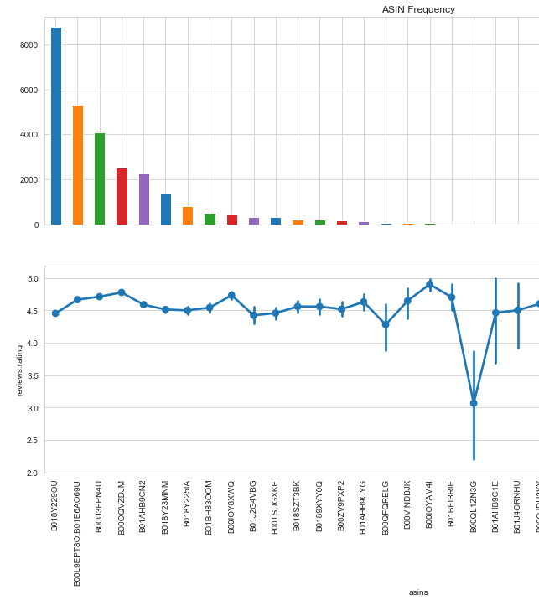
Data Exploration
Data exploration is an approach like initial data analysis where visual exploration is used to understand what is in a dataset and the characteristics of the data.

Slide 12
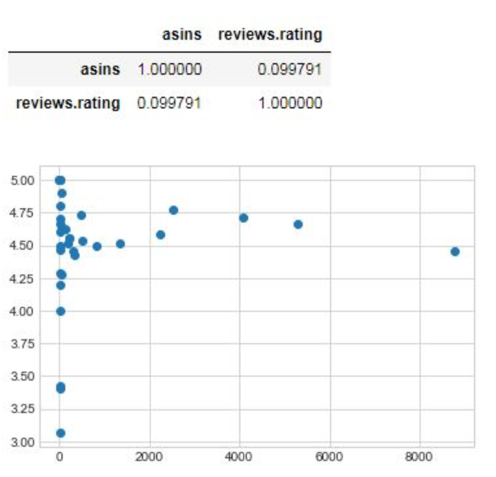
Correlation between Tables
From our analysis in data exploration above between ASINs and reviews.rating, we discovered that there are many ASINs with low occurrence that have high variances

Slide 13
Sentiment Analysis
We have to build a classifier that can determine a review’s sentiment.
Set target variable
Extra Features
Building a Pipeline from the Extracted Features.

Slide 14

Testing Model
Multinominal Naive Bayes Classifier gives around 93% accuracy.
Testing the model on other classifiers to find the best fit.

Slide 15

Testing Other Models
Logistic Regression Classifier:
Support Vector Machine Classifier:
Decision Tree Classifier:
Random Forest Classifier:

Slide 16
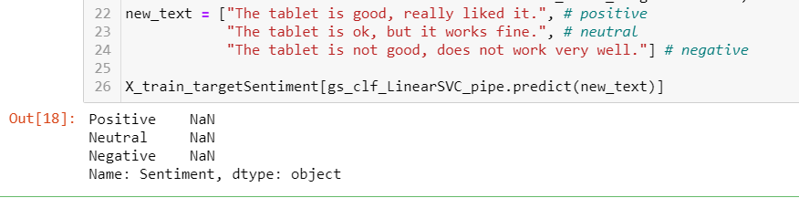
RESULTS

Slide 17
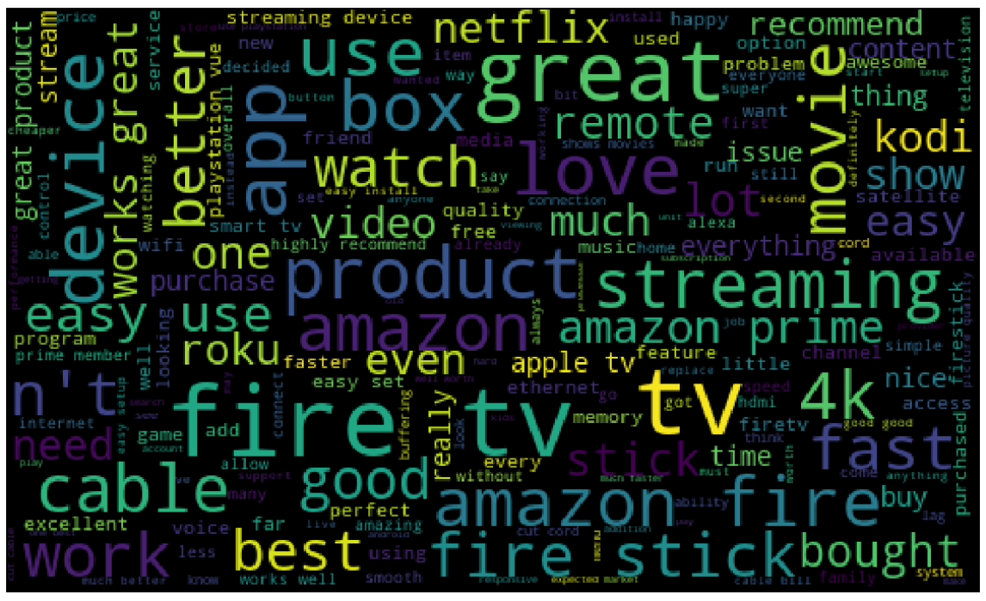
Word cloud
We have also implemented a word cloud which will give information about the most used words in the reviews for a particular brand.

Slide 18
Future Work
Detecting unfair reviews
Time taken can be improved

Slide 19
CONCLUSION
Although we need more data to balance out the lower rated products to consider their significance, however we were still able to successfully associate positive, neutral and negative sentiments for each product in Amazon’s Catalog.

Slide 20
Thank You

